Slide 1
Советы по усилению редколлегии журнала и интеграции в мировое научное пространство. Опыт Бразилии и Китая
Aliaksandr Birukou
Senior Editor

Slide 2
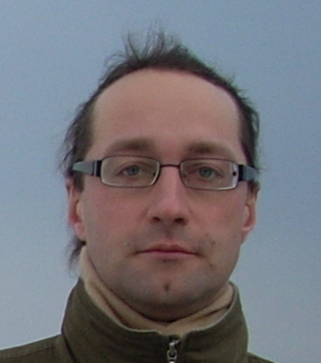
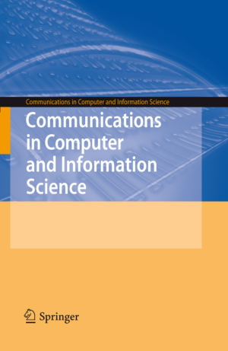
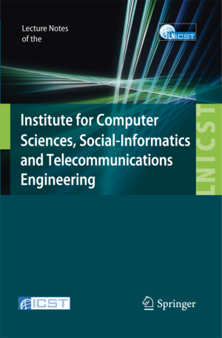
A little about me…
Александр Бирюков
Aliaksandr (Alex) Birukou Senior Editor, Computer Science PhD in Computer Science aliaksandr.birukou@springer.com With a focus on publishing Conference Proceedings Supervise the following series:

Slide 3
Outline
Brazil
Journal of Brazilian Computer Society
Journal of Internet Services and Applications
China
Playing with metrics – be careful
Resources for authors

Slide 4
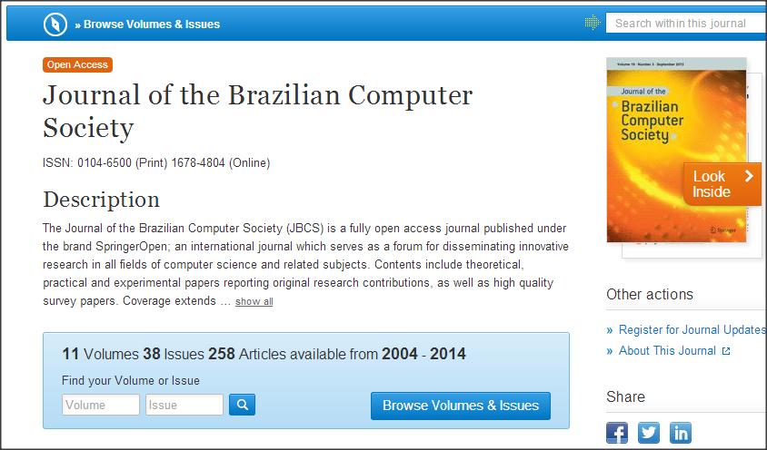
JBCS
Open access journal publishing research in all computer science topics

Slide 5
JBCS history
1995 – journal launched as “Revista Brasileira de Computação”
Apr 1997: Admitted to the SciELO collection http://www.scielo.br/
2005: Indexing in SciELO interrupted
2008: Readmitted to SciELO
Nov 2010: stopped indexing in SciELO
2010 transferred to Springer
2014 became Open Access
Issues from 2004 till now are available on SpringerLink

Slide 6
2010: Editorial board change
Editor-in-chief Maria Cristina Ferreira de Oliveira, Brazil
Editorial board Tiziana Margaria, Germany Valmir C. Barbosa, Brazil Mike Hinchey, USA Flávio Rech Wagner, Brazil Gert-Jan de Vreede, USA Edmundo Albuquerque de Souza e Silva, Brazil Gerry Stahl, USA Nivio Ziviani, Brazil
Editor-in-chief Maria Cristina Ferreira de Oliveira, Brazil
Editorial board Virgilio Almeida, Brazil
Hernán Astudillo, Chile
Ricardo Baeza-Yates, Chile
Jean Pierre Briot, France
Ana Cavalcanti, United Kingdom
Luciano da Fontoura Costa, Brazil
Luiz Marcio Cysneiros, Canada
Alípio Mário Jorge, Portugal
Oscar Pastor López, Spain
Nelson Delfino D'Avila Mascarenhas, Brazil
Andrew McGettrick, United Kingdom
Claudia Bauzer Medeiros, Brazil
Daniel Menasce, United States
Gustavo Rossi, Argentina
J. Alfredo Sanchez, Mexico
W. Eric Wong, United States

Slide 7
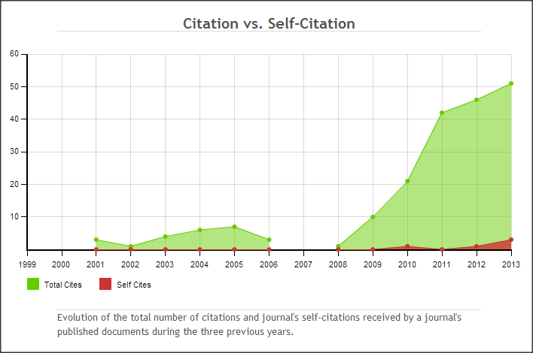
History of the journal on SCImago
Data from: http://www.scimagojr.com/journalsearch.php?q=01046500&tip=iss&exact=yes%3E

Slide 8
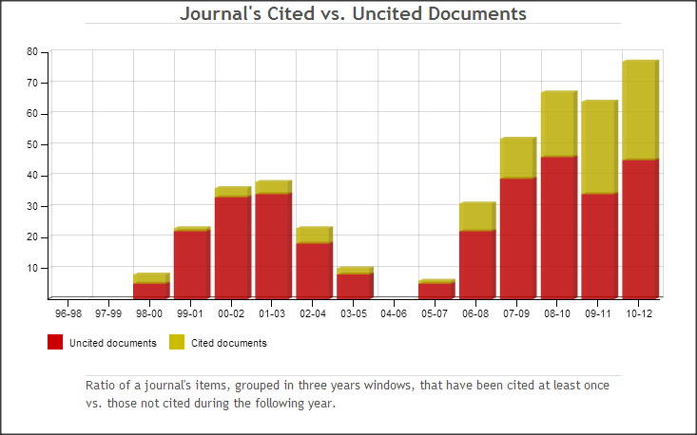
History of the journal on SCImago
Data from: http://www.scimagojr.com/journalsearch.php?q=01046500&tip=iss&exact=yes%3E
Notes:
Look at citations per doc

Slide 9
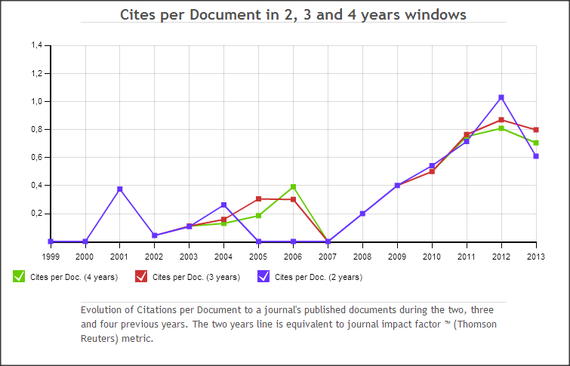
History of the journal on SCImago
Data from: http://www.scimagojr.com/journalsearch.php?q=01046500&tip=iss&exact=yes%3E
Notes:
Look at citations per doc

Slide 10
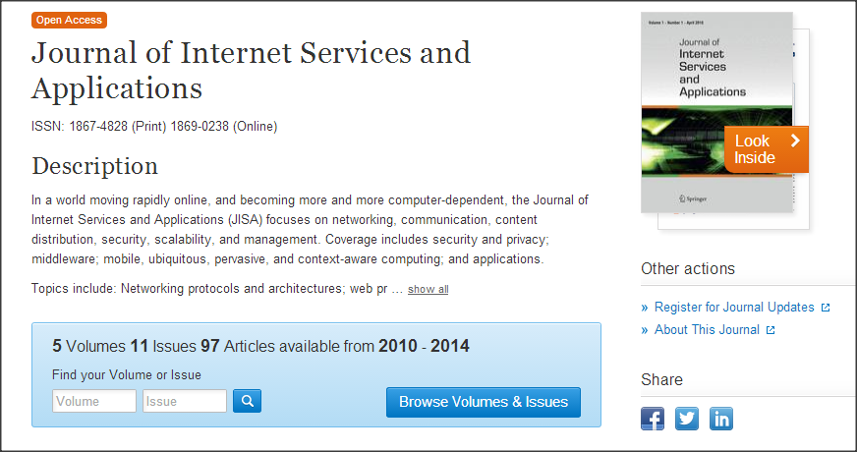
JISA history
2009 launched as Open Access journal published by Springer

Slide 11
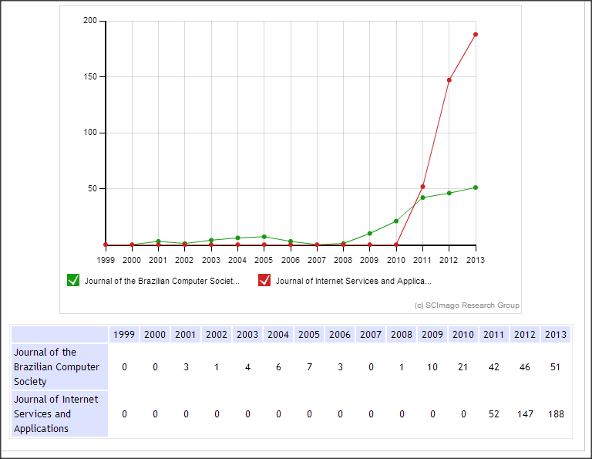
JISA vs JBCS: Total Cites (3 years)
Info from http://www.scimagojr.com/compare.php?un=journals&j1=Journal%20of%20the%20Brazilian%20Computer%20Society&j2=Journal%20of%20Internet%20Services%20and%20Applications&j3=&j4=&inj=4

Slide 12
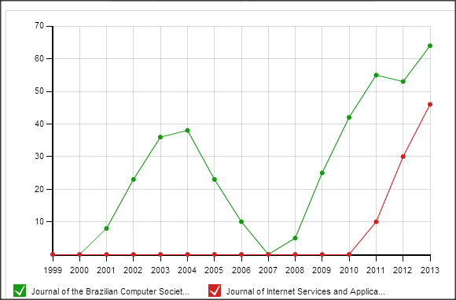
JISA vs JBCS: Citeable documents (3 years)
Info from http://www.scimagojr.com/compare.php?un=journals&j1=Journal%20of%20the%20Brazilian%20Computer%20Society&j2=Journal%20of%20Internet%20Services%20and%20Applications&j3=&j4=&inj=4

Slide 13
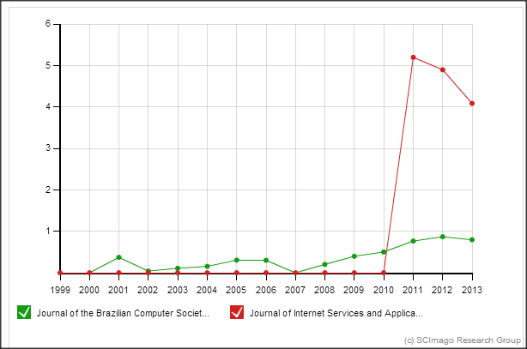
JISA vs JBCS: Cites per doc (3 years)
Info from http://www.scimagojr.com/compare.php?un=journals&j1=Journal%20of%20the%20Brazilian%20Computer%20Society&j2=Journal%20of%20Internet%20Services%20and%20Applications&j3=&j4=&inj=4

Slide 14
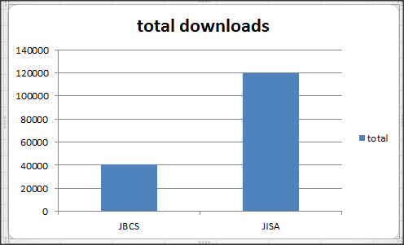
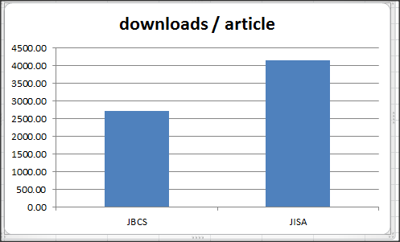
JISA vs JBCS – Downloads in 2014

Slide 15
JISA vs JBCS – Editorial Board
Editorial Board | Journal
Country | JBCS | JISA
Argentina | 1 | 1
Belgium |  | 1
Brazil | 13 | 6
Canada |  | 3
China |  | 1
France |  | 3
Germany |  | 2
Ghana |  | 1
Japan |  | 1
Korea |  | 1
Mexico |  | 1
New Zealand |  | 1
Portugal |  | 1
Spain | 1
The Netherlands |  | 1
UK |  | 6
USA | 1 | 5
Total | 16 | 35

Slide 16
JISA vs JBCS – Paper flow in 2014
Algeria | 1
Australia | 1
Belgium | 1
Brazil | 6
Canada | 4
China | 2
Finland | 2
France | 3
Germany | 4
Hong Kong | 2
India | 10
Japan | 1
Malaysia | 1
Netherlands | 1
Nigeria | 1
Pakistan | 3
Portugal | 4
Switzerland | 2
Thailand | 1
United Arab Emirates | 1
United Kingdom | 6
United States of America | 6
Brazil | 43
Chile | 1
France | 1
India | 2
Iran | 1
Nigeria | 1
Portugal | 1
United States of America | 1
Includes papers submitted, accepted, or rejected during 2014

Slide 17
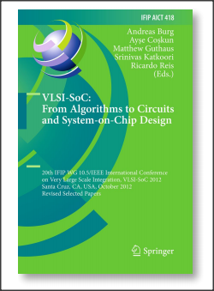
VLSI-SoC story
Conference on Very Large Scale Integration (VLSI) and System on Chip (VLSI-SoC)
Brazil wins a right to host VLSI-SoC in 1997
Brazil is a member of IFIP (International Federation of Information Processing) since 1994
People from Brazil were participating in IFIP TC meetings and got involved in VLSI-SoC PC
they got there by publishing good research at VLSI-SoC conference
This lead to:
Many Brazilian authors submitted not only for VLSI-SoC, but also next year
Now the conference is very popular among Brazilian community
Notes:
Thanks to Ricardo Augusto da Luz Reis Professor do Instituto de Informática da Universidade Federal do Rio Grande do Sul – UFRGS
...accidentally, Brazil was competing for VLSI-SoC in 1997 with Russia

Slide 18
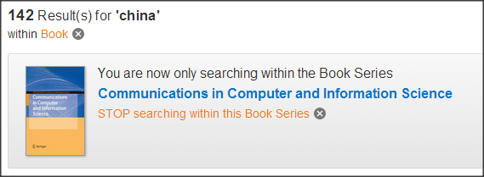
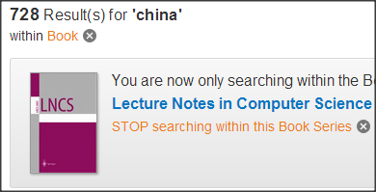
China: different focus
Main interest is on publication of conference proceedings
Cooperation with important societies, such as CCF plays an important role
-- since 1962, the largest independent national academic
organization in computer science in China;
-- 15000 members, 32 Technical Committees;
-- owns 16 local journals/magazines; sponsors or co-sponsors 48 national/regional conferences;

Slide 19
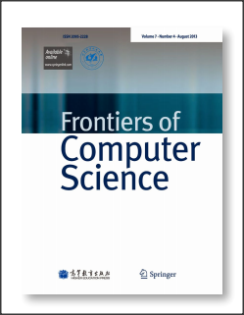
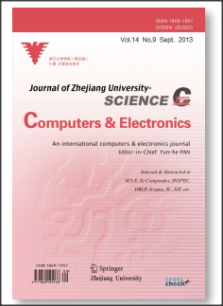
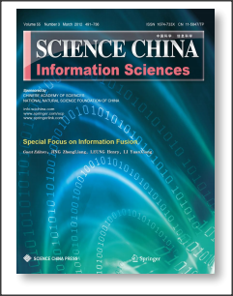
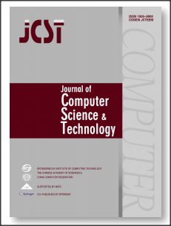
China: Journals
Impact Factor:
0.405 (2013)
Impact Factor:
0.380 (2013)
Impact Factor:
0.702 (2013)
Impact Factor:
0.642 (2013)
Notes:
all ISI-indexed journals are co-published with Springer

Slide 20
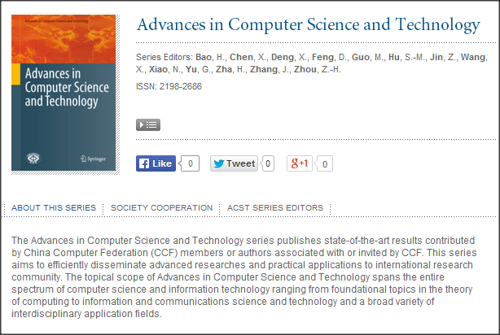
A dedicated book series launched

Slide 21
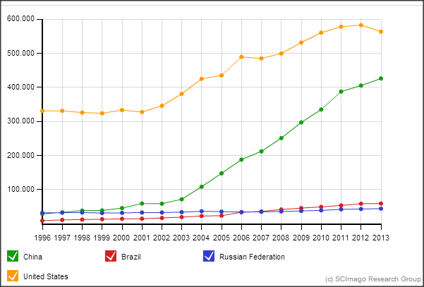
Country comparison: Total num of publications
Source: http://www.scimagojr.com/compare.php?un=countries&c1=CN&c2=BR&c3=RU&c4=US&area=0&category=0&in=h

Slide 22
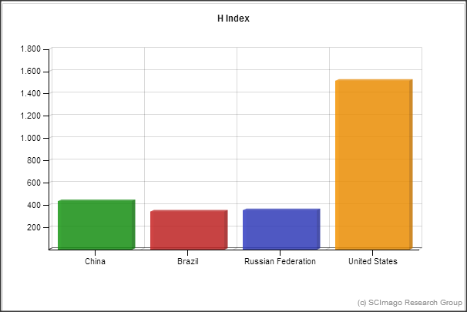
Country comparison: H-Index
Source: http://www.scimagojr.com/compare.php?un=countries&c1=CN&c2=BR&c3=RU&c4=US&area=0&category=0&in=h

Slide 23
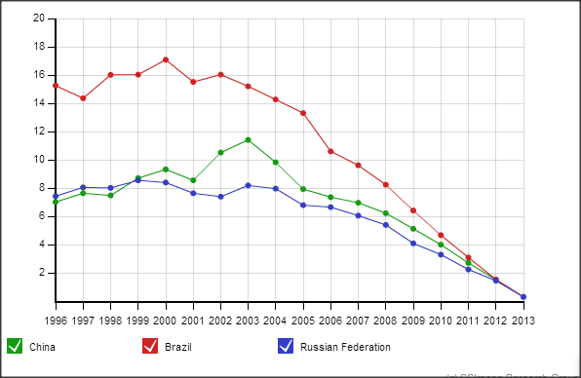
Country comparison: Citations/document
Source: http://www.scimagojr.com/compare.php?un=countries&c1=CN&c2=BR&c3=RU&c4=US&area=0&category=0&in=h

Slide 24
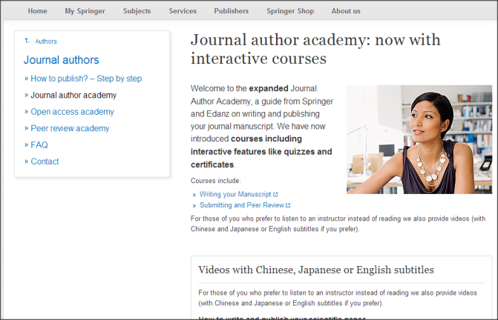
Resources for authors
Edit the title via View → Presentation Views → Slide Master
Journal author academy:
http://www.springer.com/gp/authors-editors/journal-author/journal-author-academy
You may use this text box to note the location of your saved presentation

Slide 25
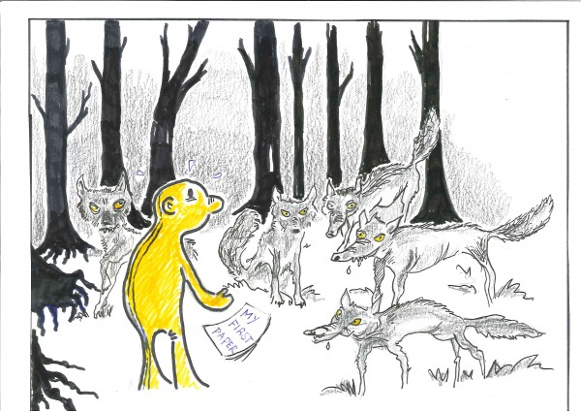
Predatory publishing
Source http://weblog.library.tudelft.nl/wp-content/uploads/2013/02/predatory-OA-publishers-600x424.jpg

Slide 26
Примерная схема работы «пиратов»
Создать веб сайт журнала или конференции, насколько возможно красивый и внушающий доверие
могут использоваться сходство с известным журналом –конф-ей
Массовые рассылки ученым, с предложением подачи статей
Упор на индексирование, импакт фактор, а не на тему
Статьи «рецензируются», важный момент – оплата счета за публикацию или регистрации на конференции
Что происходит дальше?
В идеале, статья публикуется и индексируется
Конференция не обязательно проходит, или вы оказываетесь в комнате, где местный аспирант пытается организовать презентации и обсуждения статей
Статья может пропасть вместе с сайтом через пару лет

Slide 27
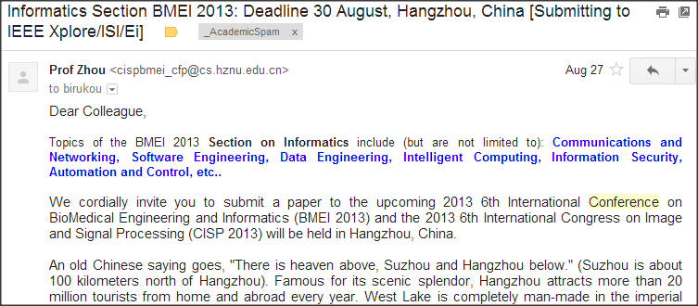
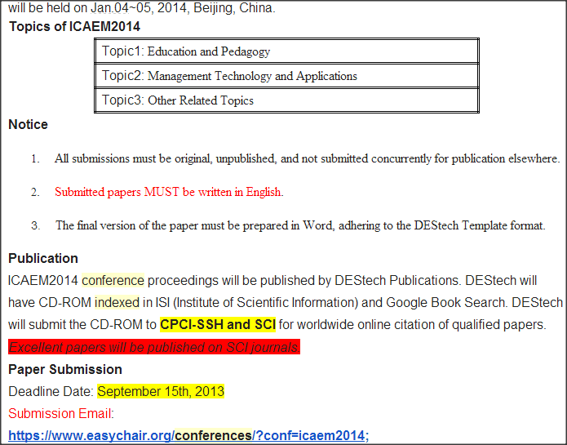
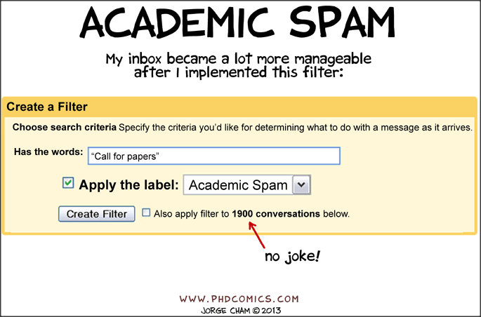
Top conferences and journals do not SPAM your mailbox...

Slide 28
Indexing vs Quality
Getting a paper in Web of Science or Scopus should not have higher priority than publishing in a reputable venue, which brings your research to scientists in your field
In Russia and Kazakhstan the number of publications in dubious journals is increasing
Избегайте следующих журналов, в частности:
World Applied Sciences Journal
Life Science Journal
Middle East Journal of Scientific Research
Actual Problems of Economic
Notes:
это псевдожурналы, готовые за плату $400–600 напечатать любую наукообразную ерунду
Most of reseach published in 2013-2014

Slide 29
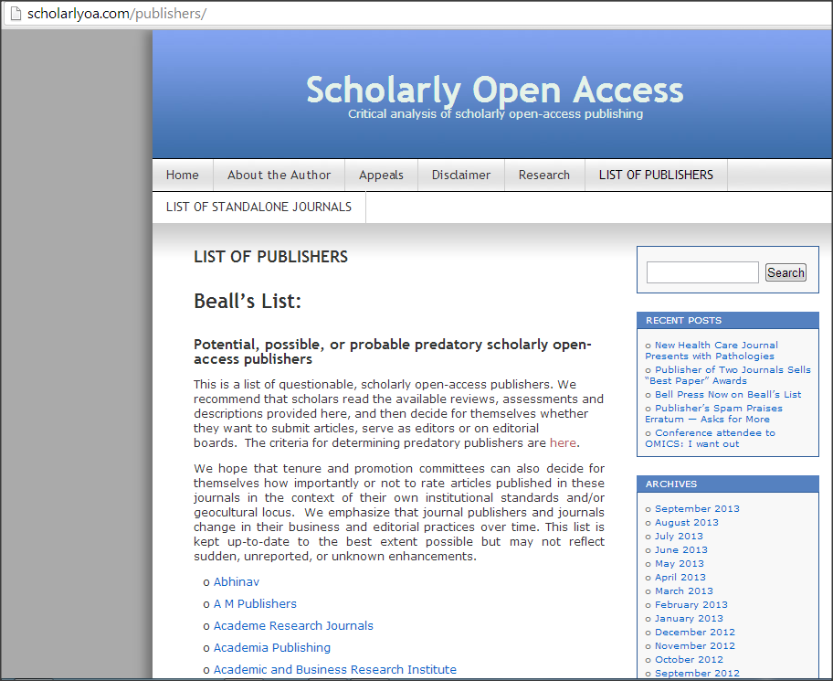
Beall’s List

Slide 30
Advice from Matt Holland
Five things librarians can do:
Add to the advice we already give potential authors a warning about predatory publishers.
Remind our users (again) that the Internet is a dangerous place. Using library provided database and resources adds a level of security to the quality of the information they find.
Be informed about current changes in publishing. Predatory publishing is a side effect of new(ish) Gold OA publishing business models.
Be vigilant about the activities of predatory publishers. It looks like they might be here to stay. Knowing they are out there is some protection for us and our users.
Share information with colleagues through professional networks if you identify suspect journals or publishers.
source_ http://www.cilip.org.uk/cilip/blog/are-we-doing-enough-warn-users-about-predatory-journals

Slide 31
Advice from Matt Holland
Five things your users should be told:
Never respond to unsolicited mail. Researchers may think they are great but it is unlikely that an email that begins Dear Sir/Madam has any insights to offer.
Check the people you are dealing with are the people you think they are. It only takes a minute to check the website or read the email address.
Use credible Open Access publishers with a track record, or established pay for view publishers with Open Access options.
Ask your Librarian to do some research on a title for you if you are unsure or if it is new.
Check the advice on how to spot a predatory journal.
- See more at: http://www.cilip.org.uk/cilip/blog/are-we-doing-enough-warn-users-about-predatory-journals#sthash.Pvyu0qLU.dpuf
source_ http://www.cilip.org.uk/cilip/blog/are-we-doing-enough-warn-users-about-predatory-journals

Slide 32
Predatory publishing
http://www.time.kz/articles/nu/2014/09/11/nauchnij-podkop
http://slon.ru/economics/simulyatsiya_nauki_kak_otvet_na_upravlencheskiy_primitivizm-1148735.xhtml
http://www.editage.cn/file/science_2013_hvistendahl_publication_market.pdf
scholarlyoa.com
http://www.cilip.org.uk/cilip/blog/are-we-doing-enough-warn-users-about-predatory-journals

Slide 33
Any questions?
Thank you Good luck!
Notes:
Are there any questions about ANYTHING I have presented today?

